Slide 1
Market Analysis Project Report
A data-driven investigation of order patterns, product performance, and reorder behavior to optimize marketing strategy and improve customer satisfaction

Slide 2
PRESENTATION OVERVIEW
Contents
01
Executive Summary
07
Analysis Queries 1-10
02
Project Background & Objectives
08
Analysis Queries 11-20
03
Dataset Overview
09
Power BI Dashboards
04
Architecture & Methodology
10
Key Findings & Business Insights
05
SQL Validation
11
Recommendations & Impact
06
Python Data Preparation
12
Conclusion
2 / 55

Slide 3
01-04
Online grocery platforms generate huge daily logs. Structuring and analysing this raw data transforms it into valuable business insights regarding customer behaviour and product performance.
Business Overview
Understanding Business Problem, Project Objective & Creating Analytical Framework

Slide 4
Executive Summary
63,100
49,355
134
21
10.5
59.85%
Customers
Products
Aisles
Departments
Avg Items/Order
Reorder Rate
Three-Stage Integrated Analysis
This report presents a comprehensive analysis of online grocery ordering behavior covering 63,100 customers, 49,355 products, 134 aisles, and 21 departments.
The analysis was conducted across three integrated stages:
1. Data validation and exploration in MySQL
2. Statistical and behavioral analysis in Python
3. Executive visual reporting in Power BI
Key Findings at a Glance
The business is a high-frequency, low-basket-value grocery operation built around fresh, perishable staples.
Produce and dairy dominate order volume and reorder rate
Peak ordering: 9 AM - 5 PM, highest Sun-Mon
Perishable categories show 3-4x higher reorder rates
A small set of SKUs carries disproportionate demand
Clear time-of-day and day-of-week seasonality
Single Most Decision-Ready Finding: Convergent evidence across four independent metrics confirms that a small set of perishable staples anchors customer engagement, while the majority of the 49,355-product catalogue sees minimal repeat engagement.
3 / 55

Slide 5
Project Overview & Background
Online grocery platforms generate large volumes of transactional data daily — what was ordered, when, by whom, how it was categorized, and whether it was purchased again.
On its own, this data is simply a log of activity. Its business value only emerges when it is validated, structured, and analyzed to reveal repeatable patterns in customer behavior and product performance.
Dataset Structure
Relational dataset (project_orders) modelled on the Instacart Market Basket dataset, comprising five linked tables:
aisles | departments | products | orders | order_products_train
The order_products_train table maps products to orders flagged with eval_set = "train" — the labelled, analysis-ready slice.
Three-Stage Engagement Structure
01
MySQL Validation
02
Python Analysis
03
Power BI Dashboards
Connect to hosted database, validate data integrity, perform first-pass exploration. Check schema, row counts, relationships.
Merge five tables into analytical dataset. Answer 20 business questions with statistical analysis and exploratory charts.
Convert processed output into four interactive executive dashboards for non-technical stakeholders and decision-makers.
Analytical Discipline: Every finding was pushed one step further than "what happened" to explain why it matters and what action it implies. Each of the 20 brief questions was addressed using the same three-layer approach: SQL for validation, Python for quantitative analysis, and Power BI for stakeholder-facing visualization.
4 / 55

Slide 6
Business Problem
Grocery e-commerce operates on thin margins and high order frequency, which means small improvements in basket size, reorder rate, or delivery-slot efficiency compound into meaningful revenue impact. Without a structured view of purchasing behavior, Marketing and Merchandising teams are left to make decisions based on intuition rather than evidence.
CORE PROBLEM
How can historical order data be used to optimize marketing strategy and improve customer satisfaction?
Three Linked Analytical Questions
What happened?
Why did it happen?
What should stakeholders do?
What are the dominant patterns in product demand, reorder behavior, and order timing?
What structural or behavioral factors explain those patterns?
Which concrete, data-backed actions should Marketing, Merchandising, and Operations take?
Scope of Decisions Addressed: Which products to promote, which time slots to prioritize, which customers are at risk of churn, how to allocate staffing and delivery resources, where to rationalize the product catalogue, and how to design replenishment-based marketing programs (e.g., subscribe-and-save on top reorder items).
5 / 55

Slide 7
Project Objectives & Analytical Framework
The project brief specified 20 analytical questions spanning product catalogue structure, customer behavior, order timing, and reorder patterns. These were grouped into four analytical objectives that map directly to business decisions:
Catalogue & Assortment Objective
Customer Behavior Objective
Questions 1-3, 20
Questions 5, 6, 10, 11, 14, 19
Quantify product distribution across departments and aisles. Identify which categories carry the most SKUs versus the most demand.
Profile customer base by order frequency, basket size, department reach, and purchase cadence.
Temporal / Demand-Timing Objective
Product Performance & Loyalty Objective
Questions 7, 8, 15, 16, 18
Questions 4, 9, 12, 13, 17
Identify peak ordering hours and days, and how basket size shifts across the week, to inform staffing and promotional scheduling.
Surface products and aisles with highest reorder rates, and categories that anchor repeat purchase behavior.
Unified Analytical Discipline
Each objective is addressed using the same three-layer discipline: SQL for validation, Python for quantitative analysis, and Power BI for stakeholder-facing visualization — with every finding pushed one step further than "what happened" to explain why it matters and what action it implies. This ensures triangulated, cross-checked conclusions that can be trusted for business decision-making.
6 / 55

Slide 8
Dataset Overview — Five-Table Relational Schema
Table | Description | Records | Primary Key
Aisles | Aisle reference list (aisle_id -> aisle name) | 134 | aisle_id
Departments | Department reference list (dept_id -> dept name) | 21 | department_id
Products | Product catalogue (product_id, name, aisle_id, dept_id) | 49,355 | product_id
Orders | One row per order (user_id, eval_set, order timing) | 1,048,575 | order_id
Order Products (Train) | One row per product within an order (order_id, product_id, cart, reordered) | 1,048,575 | order_id + product_id
Key Structural Points
Train-set scope: The order_products table is explicitly named order_products_train and only maps to orders where eval_set = "train". This is a deliberate, labelled analytical subset (consistent with the standard Instacart dataset design), not the full order history.
After merging, the analytical base table (master_df) contains 318,051 order-product line items.
Row-count ceiling: Both the orders and order_products_train tables report exactly 1,048,575 rows — one short of 2^20 (1,048,576), the well-known row-import ceiling of tools such as Excel/CSV-based bulk loaders.
This suggests the source tables were truncated at import rather than reflecting a naturally occurring row count. Noted as a data-limitation caveat.
Table Relationships: order_id connects Orders and Order Products | product_id connects Order Products and Products | aisle_id connects Products and Aisles | department_id connects Products and Departments. These relationships allow comprehensive analysis combining customer, product, and order information.
7 / 55

Slide 9
Dataset Schema & Data Quality Results
Data Quality Result
Independent validation in both SQL and Python confirmed zero missing values and zero duplicate primary keys across all five tables. Referential integrity held across every join. One exception: an aisle labelled "missing" (aisle_id 100) containing 1,254 products — a real category value, not a null.
Entity Relationship Overview
Validation Checks Performed
Relationship | Join Key | Cardinality
Orders ↔ Order Products | order_id | 1 : Many
Order Products ↔ Products | product_id | Many : 1
Products ↔ Aisles | aisle_id | Many : 1
Products ↔ Departments | department_id | Many : 1
✓ Primary key uniqueness verified (product_id, order_id, aisle_id, dept_id)
✓ Foreign key referential integrity confirmed across all joins
✓ NULL value scan across all columns in all five tables
✓ Duplicate record audit using primary key constraints
✓ Complete database join combining all five tables validated
✓ Row counts independently confirmed in SQL and Python
"Missing" Aisle Note: During validation, aisle_id 100 with the name "missing" was identified containing 1,254 products. This was verified as an actual aisle label in the source data rather than a data quality issue. The products in this aisle were treated as a legitimate category throughout the analysis. All findings in this report describe patterns within the train-set slice (master_df: 318,051 rows x 15 columns).
8 / 55

Slide 10
Tools & Technology Stack
Layer | Tool / Technology | Purpose in this Project | Key Functions
Database | MySQL (hosted, project_orders) | Source of truth; data validation and first-pass exploration | Schema inspection, row counts, integrity checks, JOIN validation
Analysis | Python (Google Colab): Pandas, NumPy | Table merging, aggregation, and the 20-question analysis | Data merging, groupby aggregation, statistical analysis
Visualization (Analysis) | Matplotlib | Exploratory charts for peak hours and day-of-week analysis | Bar charts, order distribution plots
Visualization (Reporting) | Microsoft Power BI | Interactive executive dashboards for non-technical stakeholders | KPI cards, filters, cross-visual interactions
Data Interchange | CSV (UTF-8) | Bridge format between Python analysis and Power BI | Cleaned tables, derived results, master dataset export
Technical Environment Details
Python Environment: Google Colab with standard data science stack
Pandas - Data manipulation and aggregation
NumPy - Numerical computations
SQL Alchemy / PyMySQL - Database connectivity
Matplotlib - Data visualization
Database Environment: Hosted MySQL instance (project_orders)
Five interconnected relational tables
Primary and foreign key constraints
Direct SQLAlchemy connection from Python
Eval_set filtering for train-set isolation
Note: The CSV export layer ensures reproducibility and enables the Power BI dashboards to be refreshed as new data becomes available.
10 / 55

Slide 11
Methodology — Six-Stage Analytics Pipeline
1
Connect & Explore (SQL)
Pipeline Outputs
Connect to hosted MySQL. Inspect schema (SHOW TABLES, DESCRIBE). Capture row counts for all five tables.
SQL Validation Output:
Validated dataset integrity across 5 tables. Zero missing values, zero duplicates, full referential integrity confirmed.
Python Analysis Output:
master_df (318,051 rows x 15 columns). Answers to all 20 analytical questions with statistical evidence. Two exploratory charts (peak hours, day-of-week volume).
CSV Export Output:
Aisles, Departments, Products, Orders, Order Products, Master Dataset, Top Reordered Products, Most Reordered by Department.
Power BI Output:
4 interactive dashboards with calculated measures, KPI cards, filters, and cross-visual interactions.
Business Deliverables:
Comprehensive insights, 12 recommendations, and expected impact assessment for Marketing, Merchandising, and Operations.
2
Validate (SQL)
Check every table for missing values, duplicate primary keys, and referential integrity via join tests.
3
Load & Merge (Python)
Connect via SQLAlchemy/PyMySQL. Filter eval_set="train". Merge into master_df (318,051 rows x 15 cols).
4
Analyze (Python)
Answer all 20 brief questions using groupby/aggregation. Produce summary statistics and exploratory charts.
5
Export (Python -> CSV)
Export cleaned tables and key results to CSV as interchange layer into the visualization tool.
6
Visualize (Power BI)
Build four dashboards: Executive, Customer, Product Performance, and Department & Category Analysis.
11 / 55

Slide 12
05
Before any behavioral analysis, the raw dataset was validated directly in MySQL. This stage answers a single question that every later insight depends on: can this data be trusted?
SQL Validation
Database Exploration, Data Quality Checks & Relationship Validation

Slide 13
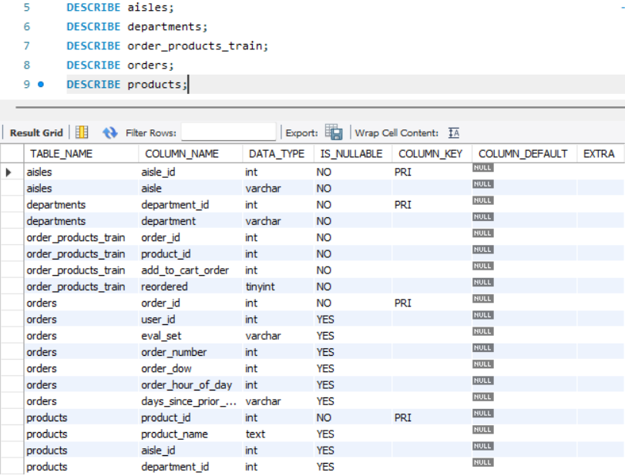
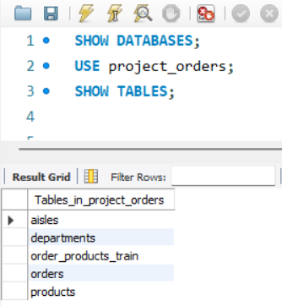
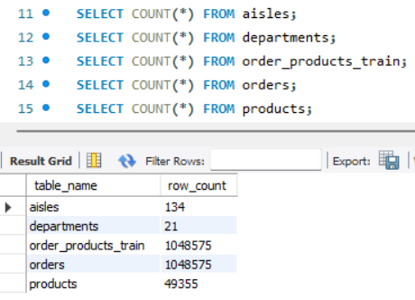
SQL Validation — Database Connection & Exploration
Database Connection
Database Exploration
Connected to the MySQL database provided for the project. The database contained five interconnected tables. To confirm a successful connection and verify available schemas, the following commands were executed:
SHOW DATABASES; | USE project_orders;
Schema explored using SHOW TABLES and DESCRIBE to identify structure, primary keys, and data types. Row counts obtained for all tables. Sample records inspected to verify data completeness and correct structure.
SQL EXPLORATION SCREENSHOTS
13 / 55

Slide 14
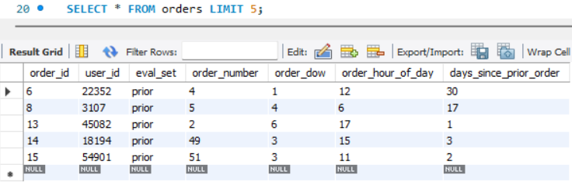
SQL Validation — Sample Data Verification
Sample records from each table were retrieved using SELECT * FROM <table> LIMIT 5 to verify structure, data format, and relationships. The following tables were explored:
Aisles: Contains unique aisle identifiers and corresponding aisle names. Departments: Contains department identifiers and names. Products: Stores product information with associated aisle and department IDs. Orders: Contains customer order details (user ID, order sequence, day, hour, days since prior). Order_Products_Train: Order-product relationships with cart sequence and reordered flag.
SAMPLE RECORDS FROM FIVE TABLES
Exploration Summary
Table | Row Count | Primary Key | Validation Status
aisles | 134 | aisle_id | Unique, no nulls
departments | 21 | department_id | Unique, no nulls
products | 49,355 | product_id | Unique, no nulls
orders | 1,048,575 | order_id | Unique, no nulls
Verification Result: The sample records confirmed that the database structure matched the provided schema and that all tables contained valid and consistent data. Primary keys were unique, foreign keys aligned correctly, and data types were appropriate for analysis. This verification ensured the dataset was ready for table joins and further analytical processing.
14 / 55

Slide 15
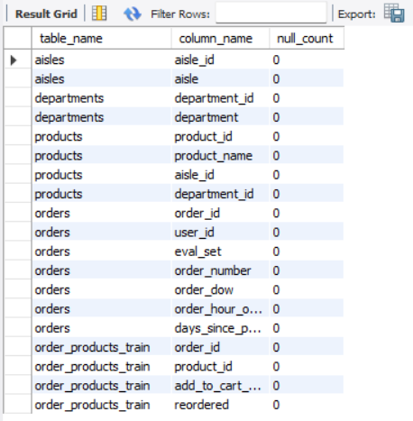
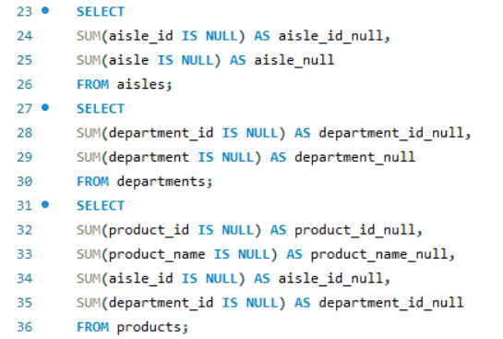
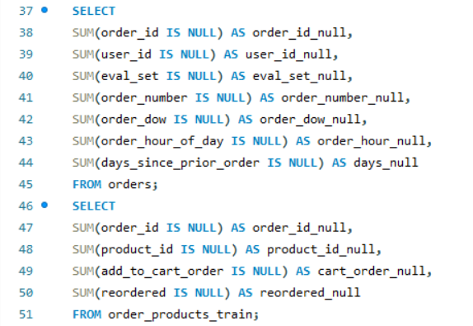
SQL Validation — Missing Value Analysis
✓
Result: No Missing Values Found. Every column across all five tables was scanned using targeted aggregation queries. No missing values were found in the dataset.
Process:
Checked all columns across all five tables for NULL values
Used targeted aggregation queries (COUNT(*) vs COUNT(column))
Verified in both SQL and Python independently
No additional data cleaning required
Implication:
The dataset is clean and analysis-ready. Since no missing values or duplicate records were found, no additional data cleaning was required before proceeding with SQL and Python analysis. This validates the dataset's reliability for business decision-making.
SQL NULL CHECK QUERIES & RESULTS
15 / 55

Slide 16
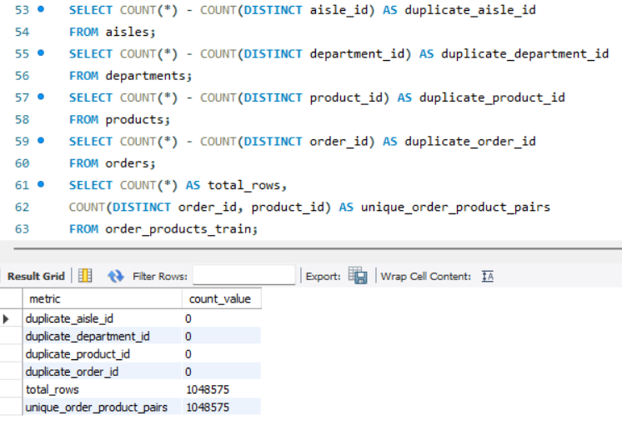
SQL Validation — Duplicate Record Verification
✓
Result: No Duplicate Records. Verified duplicate records using Primary Keys and appropriate key combinations. No duplicate records were identified across any table.
Process:
Audit conducted on all five tables
Primary key constraints verified (no overlaps)
Composite keys checked where applicable
Prevents skewed aggregations and duplicate counting
SQL DUPLICATE CHECK QUERIES & RESULTS
Implication:
All validation checks confirmed the dataset is clean, consistent, and suitable for further analysis. The absence of duplicates ensures that aggregation queries produce accurate counts and that business insights are not distorted by redundant data.
16 / 55

Slide 17
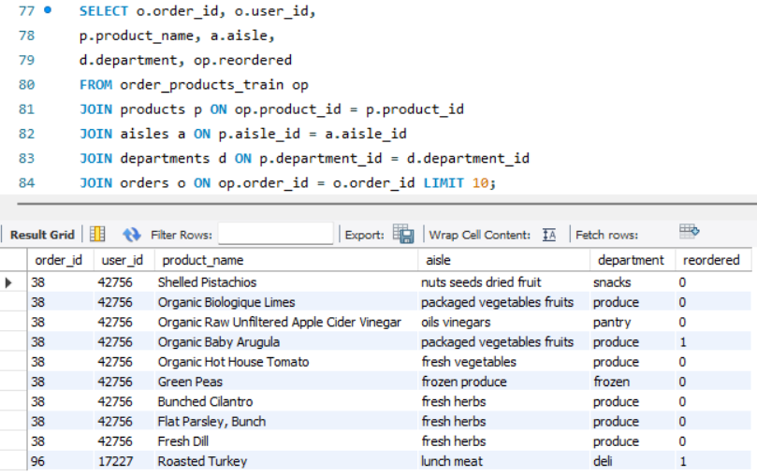
SQL Validation — Table Relationship Validation
SQL JOIN operations were performed to validate relationships among the five tables. Products were linked with aisles and departments; customer orders were connected with purchased products. These joins confirmed database relationships were accurate.
Validation Summary:
✓ All foreign key relationships validated successfully
✓ No orphaned records or broken links found
✓ Perfect referential integrity for deep-dive analysis
✓ Complete database join produces unified analytical view
✓ Dataset confirmed clean, consistent, analysis-ready
SAMPLE OF SQL JOIN VALIDATION SCREENSHOTS
Relationship | Join Key | Status
Products ↔ Aisles | aisle_id | Verified
Products ↔ Departments | department_id | Verified
Orders ↔ Order_Products_Train | order_id | Verified
Complete 5-Table Join | All keys | Verified
17 / 55

Slide 18
06-08
After SQL validation, analysis shifted to Python for advanced data manipulation. All 20 business questions were answered with supporting code, statistical analysis, and actionable business insights.
Python Data Analysis
Data Preparation, 20 Analytical Queries, Interpretations & Business Insights

Slide 19
Python Data Preparation
After SQL validation, analysis shifted to Python (Google Colab) for efficient handling of large datasets and advanced data manipulation. Python provides greater flexibility for processing, aggregation, and analysis compared to SQL.
Preprocessing Steps Performed
1. Installed required Python libraries
2. Imported Pandas, NumPy, SQLAlchemy
3. Established MySQL database connection
4. Imported all five tables into DataFrames
5. Verified dimensions of each table
6. Verified column names and data types
7. Checked for missing values (independent verification)
8. Checked for duplicate records
9. Merged five tables into single master dataset
10. Used primary/foreign keys for joins
11. Confirmed merged dataset suitability
12. Filtered to eval_set = "train"
SAMPLE OF OPERATION LIKE MERGE
orders_train = orders[orders["eval_set"] == "train"].copy()
master_df = (
order_products
.merge(orders_train, on="order_id", how="inner")
.merge(products, on="product_id", how="left")
.merge(aisles, on="aisle_id", how="left")
.merge(departments, on="department_id", how="left"))
Result: The merged dataset (master_df) contains 318,051 order-product line items across 15 columns, combining customer, product, aisle, department, and order timing data into a unified analytical base table ready for all 20 business questions.
19 / 55

Slide 20
Query 1 — Top 10 Aisles with Highest Number of Products
Objective: Identify aisles with most products | Catalogue & Assortment Objective
PYTHON CODE
# | Aisle | Total Products
1 | missing | 1,254
2 | candy chocolate | 1,235
3 | ice cream ice | 1,084
4 | vitamins supplements | 1,030
5 | yogurt | 1,023
6 | chips pretzels | 980
7 | packaged cheese | 888
8 | tea | 887
9 | frozen meals | 880
10 | cookies cakes | 869
q1_top_aisles = (
products.merge(aisles, on="aisle_id")
.groupby("aisle", as_index=False)
.agg(total_products=("product_id","count"))
.sort_values("total_products", ascending=False))
# Verify what "missing" actually means
aisles[aisles["aisle"] == "missing"]
Note: "missing" (aisle_id=100) is an actual aisle name, not incomplete data. Verified separately.
Interpretation
The "missing" aisle contains the most products (1,254). Candy Chocolate, Ice Cream, Vitamins & Supplements, and Yogurt also have large variety. Distribution indicates certain aisles have significantly broader assortment.
Business Insight: Aisles with larger product assortment require improved inventory planning, shelf management, and category organization. High-product aisles should receive greater attention during inventory replenishment and promotional planning.
20 / 55

Slide 21
Query 2 — Total Number of Unique Departments
Objective: Determine total unique departments | Catalogue & Assortment Objective
PYTHON CODE
q2_department_count = departments["department"].nunique()
print(f"Total Unique Departments: {q2_department_count}")
# Output: Total Unique Departments: 21
21
Unique Departments
Interpretation
The dataset contains 21 unique departments, representing major product categories. Each department groups products with similar characteristics, making inventory organization and performance analysis easier. This confirms the store offers a wide variety of categories.
All 21 Departments: produce, dairy eggs, snacks, beverages, frozen, pantry, household, bakery, canned goods, dry goods pasta, deli, personal care, meat seafood, breakfast, international, missing, babies, alcohol, pets, other, bulk
Business Insight: The presence of 21 departments indicates a diverse product portfolio. Department-level analysis can help management identify high-performing and low-performing categories, optimize inventory allocation, and design targeted marketing strategies for different customer segments.
21 / 55

Slide 22
Query 3 — Distribution of Products Across Departments
Objective: Analyze product distribution across departments | Catalogue & Assortment Objective
PYTHON CODE
# | Department | Total Products
1 | personal care | 6,524
2 | snacks | 6,221
3 | pantry | 5,331
4 | beverages | 4,324
5 | frozen | 3,982
6 | dairy eggs | 3,428
7 | household | 3,068
8 | canned goods | 2,073
9 | dry goods pasta | 1,845
10 | Produce | 1,671
... | (11 more) | ...
q3 = (products.merge(departments, on="department_id")
.groupby("department", as_index=False)
.agg(total_products=("product_id","count"))
.sort_values("total_products", ascending=False))
Interpretation
Personal Care has the largest assortment (6,524), followed by Snacks (6,221) and Pantry (5,331). Produce, Dry Goods, and Canned Goods contain fewer products. Distribution is highly uneven — certain departments offer much broader variety.
Business Insight: The product catalogue is concentrated in a few major departments. Personal Care, Snacks, and Pantry require greater attention in inventory planning, category management, and shelf space allocation due to their extensive product range.
22 / 55

Slide 23
Query 4 — Top 10 Products with Highest Reorder Rates
Objective: Identify highest reorder-rate products (min 100 orders) | Product Performance & Loyalty
PYTHON CODE
def top_reorder_products(min_orders):
result = master_df.groupby("product_name")
.agg(total_orders=("product_id","count"),
reorder_count=("reordered","sum"))
result["reorder_rate"] = (result["reorder_count"]
/ result["total_orders"] * 100).round(2)
return result[result.total_orders >= min_orders]
.sort_values(["reorder_rate","total_orders"],
ascending=[False,False]).head(10)
# | Product Name | Orders | Reorders | Rate
1 | Organic Low Fat Milk | 100 | 93 | 93.00%
2 | Organic Whole Milk DHA | 115 | 104 | 90.43%
3 | Milk Organic Vitamin D | 139 | 124 | 89.21%
4 | Organic Reduced Fat Milk | 274 | 242 | 88.32%
5 | Banana | 4,357 | 3,840 | 88.13%
6 | Pure Sparkling Water | 258 | 222 | 86.05%
7 | Bag of Organic Bananas | 3,522 | 3,016 | 85.63%
8 | Organic Whole Milk | 1,121 | 957 | 85.37%
9 | Organic Fat Free Milk | 188 | 160 | 85.11%
10 | Organic Large Brown Eggs | 257 | 216 | 84.05%
Threshold = 100 orders: Filters out statistically weak results from small samples, ensuring reliable business decisions.
Interpretation
Organic milk products consistently rank highest across all thresholds. Banana remains in top 10 despite thousands of orders, confirming broad-based popularity. Threshold of 100 balances sample size with reliability.
Business Insight: Organic dairy products, bananas, and sparkling water are highly loyal products that should be prioritized for inventory planning, promotional campaigns, and customer retention strategies. A minimum order threshold of 100 was selected for final analysis.
23 / 55

Slide 24
Query 5 — Total Number of Unique Users
Objective: Determine total unique customers | Customer Behavior Objective
PYTHON CODE
q5_unique_users = orders["user_id"].nunique()
print(f"Total Unique Users: {q5_unique_users}")
# Output: Total Unique Users: 63100
63,100
Unique Customers
Interpretation
The dataset contains 63,100 unique customers who have placed orders. This indicates a large and diverse customer base, making the dataset suitable for customer behavior and purchasing pattern analysis. A larger customer base improves the reliability of analytical insights.
Business Insight: The presence of over 63,000 unique customers indicates a broad market reach. This provides opportunities for customer segmentation, personalized marketing campaigns, loyalty programs, and targeted promotional strategies.
24 / 55

Slide 25
Query 6 — Average Days Between Orders Per User
Objective: Calculate avg days between consecutive orders per customer | Customer Behavior
PYTHON CODE
User ID | Avg Days Between Orders
1 | 19.00
2 | 16.29
3 | 12.00
4 | 17.00
5 | 11.50
6 | 13.33
7 | 10.45
8 | 23.33
q6_avg_days = (
orders[orders["days_since_prior_order"].notna()]
.copy()
.assign(days_since_prior_order=lambda df:
pd.to_numeric(df["days_since_prior_order"]))
.groupby("user_id", as_index=False)
.agg(avg_days_between_orders=("days_since_prior_order","mean")))
Interpretation
Average days between orders varies across customers. Some order every 10-12 days (frequent shoppers), while others wait 20+ days (occasional shoppers). This variation suggests distinct customer segments with different purchasing habits and engagement levels.
Business Insight: Customers with shorter ordering intervals are more engaged and respond well to loyalty programs. Customers with longer intervals can be targeted through personalized reminders and promotional offers to encourage repeat purchases.
25 / 55

Slide 26
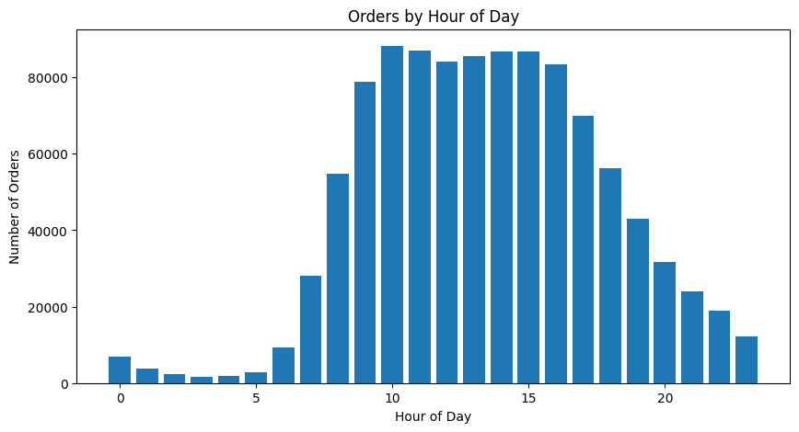
Query 7 — Peak Hours of Order Placement
Objective: Identify highest order volume hours | Temporal / Demand-Timing Objective
PYTHON CODE
q7 = orders.groupby("order_hour_of_day", as_index=False)
.agg(total_orders=("order_id","count"))
.sort_values("total_orders", ascending=False)
plt.bar(q7["order_hour_of_day"], q7["total_orders"])
Interpretation
Customer ordering is highest between 10:00 AM and 4:00 PM. The single busiest hour is 10:00 AM with 88,228 orders. Order volume gradually decreases after 4:00 PM. Lowest activity occurs during early morning hours (12:00 AM to 5:00 AM), when customer activity is minimal.
Business Insight: Customer demand is concentrated during late morning and afternoon, indicating predictable shopping behaviour. This information can be used to optimize staffing levels, warehouse operations, inventory replenishment schedules, and delivery planning during peak demand periods.
26 / 55

Slide 27
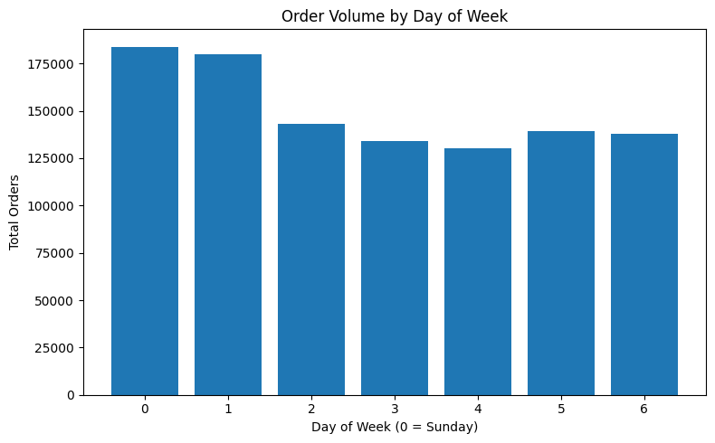
Query 8 — Order Volume by Day of Week
Objective: Analyze order distribution across days | Temporal / Demand-Timing Objective
PYTHON CODE
q8 = orders.groupby("order_dow", as_index=False)
.agg(total_orders=("order_id","count"))
.sort_values("order_dow")
plt.bar(q8["order_dow"], q8["total_orders"]); plt.xticks(range(7))
Interpretation
The highest number of orders was placed on Sunday (183,939), followed closely by Monday (180,025). Order volume gradually decreases from Tuesday to Thursday. A slight increase is observed on Friday and Saturday. Customer purchasing activity is concentrated at the beginning of the week.
Business Insight: Sunday and Monday are the busiest shopping days — critical periods for inventory availability and operational planning. Ensure adequate stock levels, workforce allocation, and delivery capacity during these peak days. Schedule promotional campaigns around high-traffic days.
27 / 55

Slide 28
Query 9 — Top 10 Most Ordered Products
Objective: Identify most frequently purchased products | Product Performance & Loyalty Objective
PYTHON CODE
# | Product Name | Total Orders | Category
1 | Banana | 4,357 | Fresh Fruit
2 | Bag of Organic Bananas | 3,522 | Organic
3 | Organic Strawberries | 2,520 | Organic
4 | Organic Baby Spinach | 2,286 | Organic
5 | Large Lemon | 1,841 | Fresh
6 | Organic Hass Avocado | 1,705 | Organic
7 | Organic Avocado | 1,661 | Organic
8 | Strawberries | 1,479 | Fresh
9 | Limes | 1,383 | Fresh
10 | Organic Raspberries | 1,279 | Organic
q9_top_ordered = (
master_df.groupby("product_name", as_index=False)
.agg(total_orders=("product_id","count"))
.sort_values("total_orders", ascending=False)
.head(10))
7 of top 10 are organic/fresh produce items
Interpretation
Banana is the most ordered product (4,357). Fresh fruits and vegetables dominate the list. Organic products (Organic Bananas, Strawberries, Spinach, Avocados) appear multiple times, indicating strong preference for organic items.
Business Insight: Fresh produce and organic products are the primary demand drivers. Maintaining adequate inventory for these high-demand products is essential to prevent stock shortages. These products can be leveraged in promotional campaigns, bundle offers, and cross-selling strategies.
28 / 55

Slide 29
Query 10 — Unique Users by Department
Objective: Identify customer reach across departments | Customer Behavior Objective
PYTHON CODE
# | Department | Unique Users | Reach %
1 | produce | 22,303 | 35.3%
2 | dairy eggs | 20,153 | 31.9%
3 | beverages | 14,024 | 22.2%
4 | snacks | 13,304 | 21.1%
5 | frozen | 11,742 | 18.6%
6 | pantry | 10,886 | 17.3%
7 | bakery | 8,326 | 13.2%
8 | deli | 7,430 | 11.8%
... | ... | ... | ...
18 | alcohol | 679 | 1.1%
19 | pets | 622 | 1.0%
20 | other | 392 | 0.6%
21 | bulk | 323 | 0.5%
q10 = (master_df.groupby("department", as_index=False)
.agg(unique_users=("user_id","nunique"))
.sort_values("unique_users", ascending=False))
Top 3 departments reach 89.4% of all customers ( produce + dairy eggs + beverages = 56,480 unique users )
Interpretation
Produce has the highest customer reach (22,303 users, 35.3%). Dairy Eggs follows (20,153). Essential grocery departments attract the largest customer bases. Bulk, Other, Pets, and Alcohol have comparatively fewer customers.
Business Insight: Essential grocery departments (Produce, Dairy Eggs, Beverages, Snacks, Frozen) should receive higher priority for inventory planning, promotional campaigns, and shelf space. Low-engagement departments may require assortment optimization or targeted marketing.
29 / 55

Slide 30
Query 11 — Average Number of Products Per Order
Objective: Calculate average basket size | Customer Behavior Objective
PYTHON CODE
q11_avg_products = master_df.groupby("order_id").size().mean()
print(f"Average Products per Order: {q11_avg_products:.2f}")
# Output: Average Products per Order: 10.51
10.51
Products Per Order (Average)
Basket Size Context:
Small basket: 1-5 items (impulse/quick shop)
Medium basket: 6-15 items (regular grocery)
Large basket: 16+ items (stock-up shopping)
At 10.51 items, the average customer falls into the medium basket category, indicating regular planned grocery trips.
Interpretation
Customers purchase an average of 10.51 products per order. This indicates most customers buy multiple products in a single session rather than making single-item purchases. The result suggests a moderate basket size reflecting planned grocery shopping behavior.
Business Insight: An average basket size of ~11 products presents opportunities for cross-selling and upselling. Retailers can increase average order value by recommending complementary products, offering bundle discounts, or promoting frequently-bought-together items during checkout.
30 / 55

Slide 31
Query 12 — Most Reordered Product by Department
Objective: Identify highest repeat-purchase product per department | Product Performance & Loyalty
PYTHON CODE
Department | Most Reordered Product | Reorder Count
produce | Banana | 3,840
dairy eggs | Organic Whole Milk | 957
beverages | Sparkling Water Grapefruit | 637
deli | Original Hummus | 539
bakery | 100% Whole Wheat Bread | 412
frozen | Blueberries | 354
pantry | Extra Virgin Olive Oil | 257
canned goods | Organic Black Beans | 215
meat seafood | Ground Turkey Breast | 170
... | ... | ...
q12 = (master_df.groupby(["department",
"product_name"], as_index=False)
.agg(reorder_count=("reordered","sum")))
q12 = q12.sort_values(["department",
"reorder_count"], ascending=[True,False])
.drop_duplicates("department")
Every department has a "hero product" driving loyalty
Interpretation
Banana dominates with 3,840 reorders in Produce. Organic Whole Milk (957) and Sparkling Water (637) show strong loyalty. Each department has a distinct flagship product. Pets, Alcohol, and Babies have lower reorder counts.
Business Insight: Flagship products of each department should be priority items for inventory management, promotional campaigns, and shelf placement. These products consistently drive repeat purchases and customer retention across all categories.
31 / 55

Slide 32
Query 13 — Products Reordered More Than Once
Objective: Measure repeat purchase product count | Product Performance & Loyalty Objective
PYTHON CODE
q13 = master_df.groupby("product_name") .agg(reorder_count=("reordered","sum"))
q13_products = (q13["reorder_count"] > 1).sum()
print(f"Products Reordered More Than Once: {q13_products}")
# Output: 11529
11,529
Products Reordered More Than Once
Out of 49,355 total products, 11,529 products (approximately 23.4% of the catalogue) have been reordered more than once. This indicates that nearly a quarter of the product range generates repeat purchase behavior, while the remaining ~76% are either one-time purchases or have very low reorder frequency.
Key Metrics
11,529 / 49,355 products reordered = 23.4%
~76.6% of products have zero or one reorder
Loyalty concentrated in perishable staples
Interpretation
A total of 11,529 products were reordered more than once. This indicates a significant portion of the catalogue experiences repeat purchases. Customers exhibit consistent purchasing behavior across many products, demonstrating product loyalty.
Business Insight: A large number of repeatedly purchased products indicates strong customer loyalty. The business should prioritize maintaining inventory for these products, use them in personalized recommendations, loyalty programs, and targeted promotional campaigns to maximize repeat sales.
32 / 55

Slide 33
Query 14 — Average Cart Size Per Order
Objective: Determine average products added to cart | Customer Behavior Objective
PYTHON CODE
q14_avg_cart = master_df.groupby("order_id")
.agg(cart_size=("add_to_cart_order","max"))
print(f"Average Cart Size: {q14_avg_cart['cart_size'].mean():.2f}")
# Output: Average Cart Size: 10.51
10.51
Average Cart Size (Products)
Note: Since add_to_cart_order reaches the maximum item position in an order, both Query 11 and Query 14 produce the same result (10.51). This cross-validation confirms the consistency of the analytical approach.
Interpretation
On average, customers add approximately 10.51 products to their cart per order. The result reflects a moderate basket size suggesting planned grocery shopping behavior. The consistency with Query 11 validates the data integrity.
Business Insight: The average cart size indicates opportunities for increasing basket value through cross-selling and product recommendations. Bundle offers, complementary product suggestions, or volume-based discounts could encourage customers to add more products per order.
33 / 55

Slide 34
Query 15 — Orders by Hour of Day (Cross-Reference)
Objective: Identify order distribution across hours | Temporal / Demand-Timing Objective
Reference: Query 7 Results
Hour | Total Orders | Rank
10 AM | 88,228 | #1
11 AM | 87,087 | #2
2 PM | 86,905 | #3
3 PM | 86,888 | #4
1 PM | 85,652 | #5
12 PM | 84,204 | #6
4 PM | 83,421 | #7
Cross-Reference Note: This query requires the same analysis performed in Query 7 (Peak Hours of Order Placement During the Day). Since both questions analyse the distribution of orders across the 24-hour period, the same Python implementation and results have been reused to avoid duplication.
The distribution indicates customers primarily place orders during regular daytime business hours, suggesting planned grocery shopping rather than impulse purchases.
Interpretation
Customer ordering activity is highest between 10:00 AM and 4:00 PM. The single busiest hour is 10:00 AM with 88,228 orders. Order volume gradually decreases after 4:00 PM. The lowest ordering activity occurs during early morning hours (12:00 AM to 5:00 AM).
Business Insight: Peak hours (10 AM-4 PM) align with medium basket sizes (~10 products), confirming planned grocery shopping behaviour. Schedule staff during peak hours, launch promotional notifications before peak windows, and allocate delivery resources accordingly.
34 / 55

Slide 35
Query 16 — Distribution of Order Sizes
Objective: Analyze frequency of small, medium, and large orders | Temporal / Demand-Timing
PYTHON CODE
Order Size | # of Orders | Category
1 | 1,536 | Small
2 | 1,742 | Small
3 | 1,883 | Small
4 | 1,890 | Small
5 | 2,032 | Medium
... | ... | ...
66 | 1 | Very Large
74 (max) | 1 | Very Large
q16 = (master_df.groupby("order_id")
.agg(order_size=("product_id","count"))
.groupby("order_size", as_index=False)
.agg(number_of_orders=("order_size","count"))
.sort_values("order_size"))
Interpretation
Smaller and medium-sized orders occur much more frequently than very large orders. As order size increases, the number of orders gradually decreases. Orders containing more than 60 products are extremely rare. Most customers prefer purchasing a moderate number of products per order.
Key Statistics:
Order sizes range from 1 to 74 products
67 distinct order sizes observed
Most frequent: 5-product orders (2,032 orders)
Orders 60+ products extremely rare (1 each)
Business Insight: Most customers prefer small-to-medium baskets, while exceptionally large orders are uncommon. Optimize inventory planning and fulfillment for typical basket sizes. Bundle offers and cross-selling may encourage larger baskets and increase average order value.
35 / 55

Slide 36
Query 17 — Average Reorder Rate by Aisle
Objective: Identify aisles with highest repeat purchase behavior | Product Performance & Loyalty
Top 5 Aisles
PYTHON CODE
# | Aisle | Reorder Rate
1 | milk | 79.30%
2 | water seltzer sparkling | 73.97%
3 | fresh fruits | 73.50%
4 | eggs | 73.46%
5 | packaged produce | 70.98%
q17 = master_df.groupby("aisle", as_index=False)
.agg(avg_reorder_rate=("reordered","mean"))
q17["avg_reorder_rate"] = (q17["avg_reorder_rate"]
* 100).round(2)
q17 = q17.sort_values("avg_reorder_rate", ascending=False)
Bottom 5 Aisles
# | Aisle | Reorder Rate
130 | kitchen supplies | 16.33%
129 | spices seasonings | 17.65%
128 | baking supplies decor | 18.25%
127 | beauty | 20.00%
126 | cold flu allergy | 21.11%
Interpretation
The Milk aisle has the highest reorder rate (79.30%). Essential categories (Water, Fresh Fruits, Eggs) show 70%+ rates. In contrast, discretionary categories (Kitchen Supplies 16.33%, Spices 17.65%, Beauty 20%) have much lower rates. Essential grocery categories achieve 3-4x higher reorder rates than discretionary ones.
Business Insight: Essential grocery categories consistently achieve higher customer retention and repeat purchases. Prioritize inventory planning and promotional campaigns for high-loyalty aisles. Explore initiatives to improve engagement in lower-performing discretionary categories.
36 / 55

Slide 37
Query 18 — Average Order Size by Day of Week
Objective: Analyze basket size variation across days | Temporal / Demand-Timing Objective
PYTHON CODE
q18 = (master_df.groupby(["order_dow","order_id"])
.agg(order_size=("product_id","count"))
.reset_index()
.groupby("order_dow", as_index=False)
.agg(avg_order_size=("order_size","mean"))
.sort_values("order_dow"))
Day (0=Sunday) | Avg Order Size | Basket Type
Day 0 (Sunday) | 11.72 | Large
Day 6 (Saturday) | 11.03 | Large
Day 1 (Monday) | 10.29 | Medium
Day 5 (Friday) | 10.20 | Medium
Day 2 (Tuesday) | 9.91 | Medium
Day 4 (Thursday) | 9.85 | Medium
Day 3 (Wednesday) | 9.67 | Medium
Range: 9.67 to 11.72 products (21% variation between min and max)
Interpretation
Largest orders on Day 0 (11.72) and Day 6 (11.03) — weekend stock-up shopping. Smallest on Day 3 (9.67). Variation is moderate (9.67-11.72), indicating relatively consistent purchasing behaviour with slight weekend uplift.
Business Insight: Customers tend to purchase larger baskets on weekends (Day 0 and Day 6), suggesting major grocery shopping days. Ensure adequate inventory, increase staff availability, and promote bundled offers during high-volume shopping days to maximize sales.
37 / 55

Slide 38
Query 19 — Top 10 Users with Highest Number of Orders
Objective: Identify most active customers | Customer Behavior Objective
PYTHON CODE
Rank | User ID | Total Orders
1 | 15,896 | 100
2 | 16,290 | 100
3 | 57,838 | 100
4 | 57,851 | 100
5 | 16,298 | 100
6 | 16,313 | 100
7 | 16,340 | 100
8 | 16,357 | 100
9 | 16,364 | 100
10 | 964 | 100
q19_top_users = (orders.groupby("user_id", as_index=False)
.agg(total_orders=("order_id","count"))
.sort_values("total_orders", ascending=False)
.head(10))
Note: 100 orders/user may represent the dataset cap, not actual maximum purchasing.
Interpretation
Top 10 customers each placed exactly 100 orders. The identical order count suggests 100 may be the dataset maximum rather than a natural pattern. These customers demonstrate consistent, highly engaged purchasing behaviour.
Business Insight: Highly active customers represent the most valuable segment. They are ideal candidates for loyalty programs, personalized offers, premium memberships, and targeted retention campaigns. Understanding their behavior can improve customer lifetime value.
38 / 55

Slide 39
Query 20 — Products in Each Aisle and Department
Objective: Determine product distribution across aisles within departments | Catalogue & Assortment
PYTHON CODE
Total of 134 department-aisle combinations identified across 21 departments.
q20 = (products.merge(aisles, on="aisle_id")
.merge(departments, on="department_id")
.groupby(["department","aisle"], as_index=False)
.agg(total_products=("product_id","count"))
.sort_values(["department","total_products"],
ascending=[True,False]))
Department | Aisle | Total Products
alcohol | beers coolers | 384
alcohol | red wines | 232
alcohol | spirits | 192
snacks | fruit vegetable snacks | 356
snacks | popcorn jerky | 315
snacks | mint gum | 168
snacks | ice cream toppings | 83
snacks | trail mix snack mix | 69
Interpretation
Certain aisles contain significantly more products than others within the same department. Alcohol: Beers Coolers (384) vs Specialty Wines (95). Snacks: Fruit Veg Snacks (356) vs Trail Mix (69). Product availability is concentrated in a few major aisles per department.
Business Insight: Understanding product distribution at department and aisle levels enables better category management, shelf space optimization, and inventory planning. Large-assortment aisles need greater merchandising attention; low-volume aisles can be evaluated for optimization.
39 / 55

Slide 40
09
After completing SQL and Python analysis, four interactive dashboards were developed in Power BI to present findings in a clear, business-friendly format for non-technical stakeholders.
Power BI Dashboards
Four Interactive Executive Dashboards for Stakeholder Self-Service

Slide 41
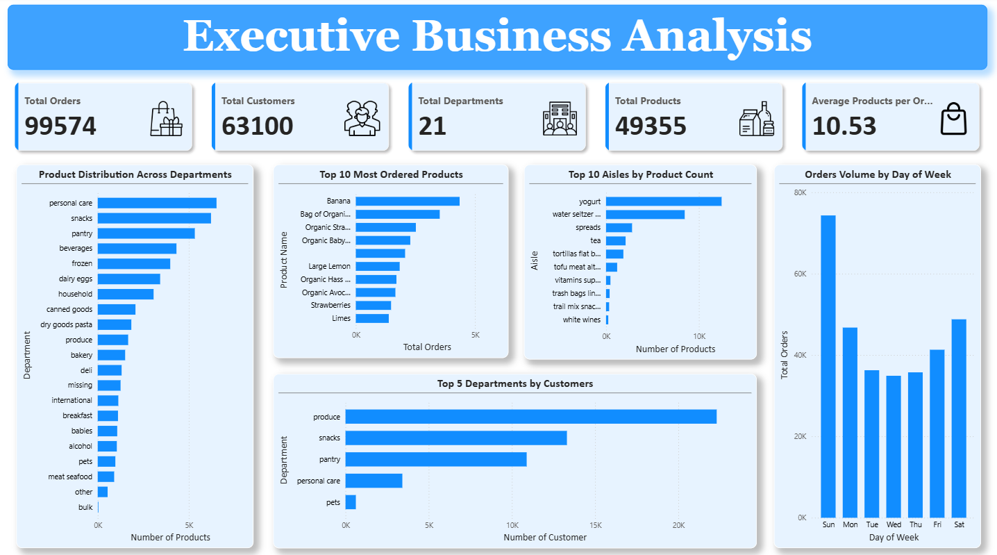
Power BI — Executive Business Analysis Dashboard
Provides a high-level summary of the supermarket's overall performance. Combines key business metrics with product, customer, and order insights for quick management understanding.
EXECUTIVE BUSINESS ANALYSIS DASHBOARD
50 / 55

Slide 42
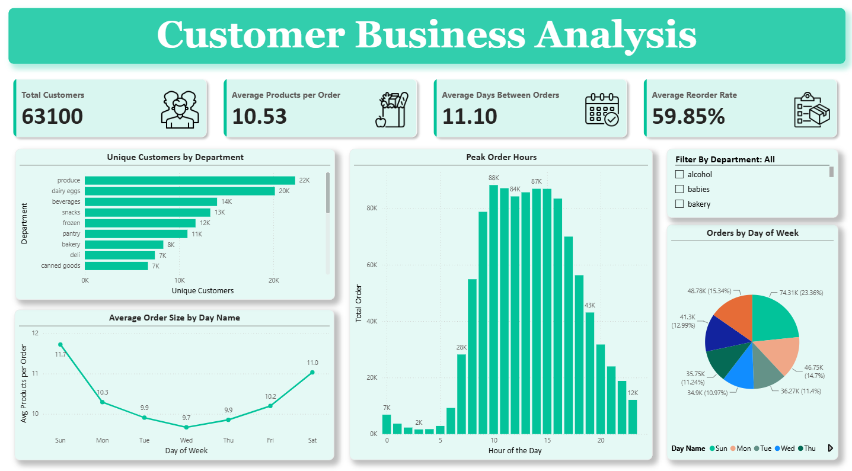
Power BI — Customer Business Analysis Dashboard
Focuses on customer purchasing behavior and shopping patterns. Provides insights into customer distribution, ordering habits, reorder behavior, and shopping trends across departments.
CUSTOMER BUSINESS ANALYSIS DASHBOARD
51 / 55

Slide 43
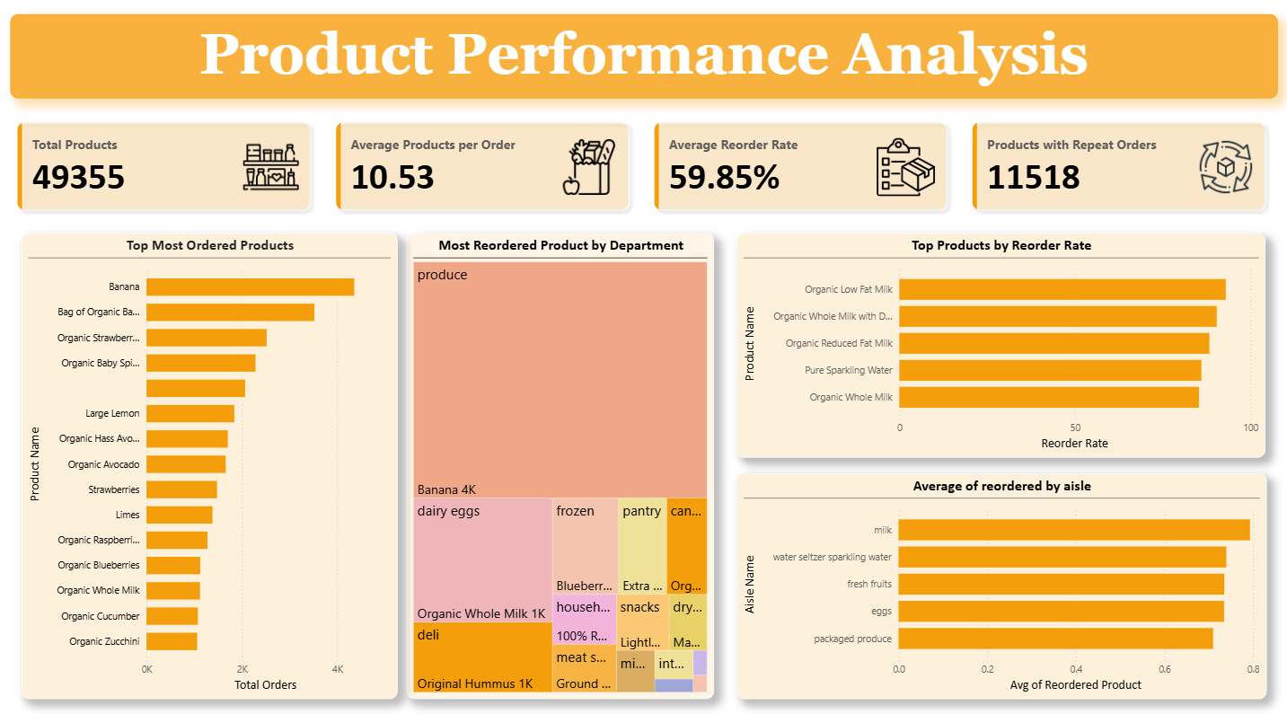
Power BI — Product Performance Analysis Dashboard
Evaluates product-level performance by analyzing purchasing patterns, reorder behavior, and demand across departments. Highlights best-performing products and identify customer loyalty.
PRODUCT PERFORMANCE ANALYSIS DASHBOARD
52 / 55

Slide 44
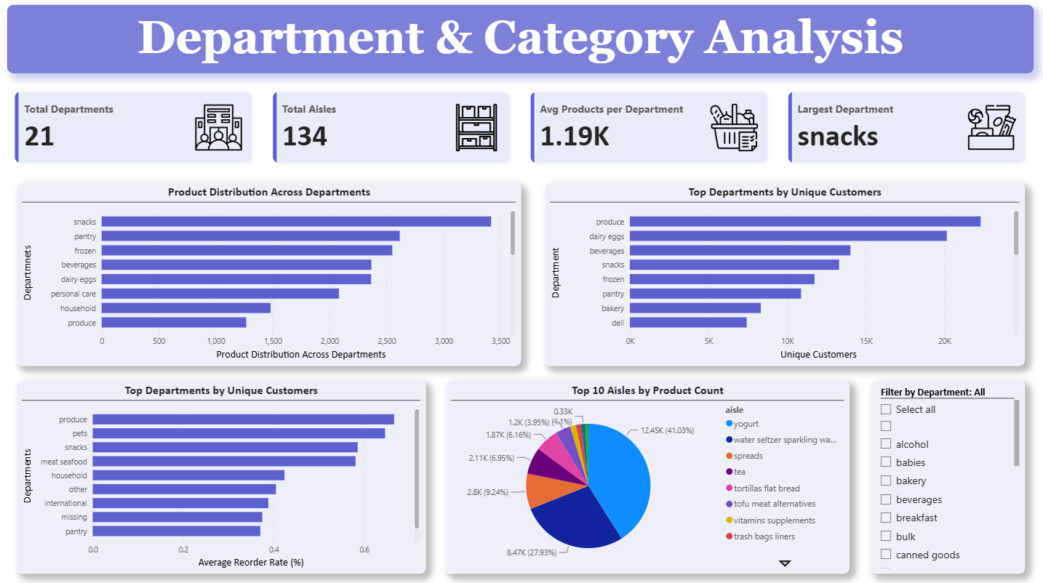
Power BI — Department & Category Analysis Dashboard
Provides a detailed view of product distribution and customer engagement across departments and aisles. Helps evaluate category performance and identify high-performing departments
DEPARTMENT & CATEGORY ANALYSIS DASHBOARD
53 / 55

Slide 45
10
Cross-referencing SQL validation, Python behavioral analysis, and Power BI dashboards produced a consistent, triangulated view of the customer base and product performance.
Key Findings & Business Insights
Cross-Analysis Variables, Product Portfolio, Customer Base, Purchasing Behaviour, Product Loyalty, Demand & Reordering Patterns

Slide 46
Key Variables from Cross Analysis
Six key cross-analysis findings emerged from triangulating SQL validation, Python analysis, and Power BI dashboard data:
1
Assortment Loyalty: Departments with the largest product assortment are not necessarily those with highest reorder rates. A wider assortment does not automatically create stronger customer loyalty.
2
Produce Punch: Produce has fewer products than Personal Care, yet serves the largest number of unique customers (22,303). Produce items are everyday essentials with broad appeal.
3
Organic Loyalty: Organic dairy products consistently appear among the highest reorder-rate products. Customers who buy organic dairy are highly loyal with repeat purchase rates exceeding 85%.
4
Planned Shopping: Peak hours (10 AM-3 PM) align with medium basket sizes (~10 products), indicating customers are doing planned grocery shopping rather than impulse purchases.
5
Fresh Produce Dominance: Fresh produce dominates both most-ordered and most-reordered products, reinforcing its importance in overall store performance and customer retention.
6
Strategic Focus: High-performing departments (Produce, Dairy Eggs, Beverages, Snacks) combine large customer reach with strong repeat purchasing, making them strategic focus areas.
Convergent Evidence: The single most decision-ready finding is the convergent evidence across four independent metrics (order volume, reorder rate, customer reach, basket composition) that a small set of perishable staples anchors customer engagement, while the majority of the 49,355-product catalogue sees minimal repeat engagement. This insight should drive the next round of assortment and retention-marketing planning.
41 / 55

Slide 47
Business Insights — Product Portfolio & Customer Base
49,355
Products in Catalogue
21
Departments
63,100
Unique Customers
10-25
Days Between Orders
A. Product Portfolio Insights
Product Catalogue and Distribution: 49,355 products across 21 departments and 134 aisles. Distribution is highly uneven — Personal Care (6,524), Snacks (6,221), Pantry (5,331) hold largest shares. Bulk is smallest with only 38 products.
Impact: Inventory management should focus on departments with large assortments. Smaller departments may require assortment optimization.
Aisle Variety: Certain aisles show extremely large variety — Missing (1,254), Candy Chocolate (1,235), Ice Cream (1,084), Vitamins & Supplements (1,030).
Impact: Large aisles require better shelf planning. Higher assortment increases customer choice but also operational complexity.
B. Customer Base Insights
Customer Base: The store maintains a large active customer base of 63,100 unique customers in the dataset.
Impact: Large enough customer base for meaningful segmentation and personalized marketing campaigns.
Purchase Frequency: Customers purchase regularly, with average time between transactions typically ranging from 10 to 25 days.
Impact: Recurring purchasing behaviour creates opportunity for reminder campaigns and subscription models.
42 / 55

Slide 48
Business Insights — Purchasing Behaviour & Product Loyalty
C. Purchasing Behaviour Insights
Midday Shopping Peak: Orders peak at 10 AM, 11 AM, 2 PM, 3 PM. Lowest volumes occur 2 AM-5 AM.
Impact: Schedule staff during peak hours. Launch promotional notifications before peak windows.
Weekend Busier: Order volume peaks on Saturday and Sunday. Wednesday has lowest traffic.
Impact: Increase inventory and staffing during busy days.
Basket Size: Customers purchase avg 10.51 products per order. Order sizes range 1-74, but most are small-to-medium baskets.
Impact: Cross-selling opportunities exist. Bundle offers may encourage larger baskets.
D. Product Loyalty Insights
Organic Loyalty: Organic dairy products show exceptionally strong loyalty. Organic Low-fat Milk, Whole Milk, DHA, Reduced Fat Milk all maintain reorder rates exceeding 85% at 100-order threshold.
Impact: Organic products drive repeat purchases — expand and promote.
Bananas Dominate: Bananas rank as both highest-ordered and highest-reordered item in Produce department.
Impact: Core demand driver — inventory shortages directly affect satisfaction.
Department Hero Products: Each department has its own loyalty driver — Banana (Produce), Organic Whole Milk (Dairy), Original Hummus (Deli), Sauvignon Blanc (Alcohol).
Impact: Department-specific promotions should focus on these hero products as traffic drivers.
43 / 55

Slide 49
Business Insights — Customer Reach, Demand & Reordering
E. Customer Reach Insights
Produce Reaches the Largest Number of Customers: The Produce department reaches the largest customer base (22,303), followed by Dairy Eggs (20,153), Beverages (14,024), and Snacks (13,304) as categories with highest unique customer counts.
Impact: These departments attract the broadest customer base and deserve greater promotional investment.
F. Product Demand Insights
Fresh Produce Dominates Orders: Fresh produce dominates customer orders, with top-ordered products consisting of bananas, organic bananas, organic strawberries, organic baby spinach, avocados, and lemons.
Impact: Fresh produce drives customer traffic. Demand forecasting is especially important for perishables to prevent stockouts and waste.
G. Reordering Behaviour Insights
High Reorder Rates Need Context: While several products initially showed 100% reorder rate, these figures were skewed by low purchase volumes. Applying a minimum threshold of 100 orders established a much more reliable metric.
Impact: Business decisions should not rely solely on percentages; sufficient sample size is essential. Combine reorder rate with total order volume for reliable conclusions.
Insight Summary Matrix
Produce = highest reach (22,303 customers) + dominates orders + dominates reorders | Organic dairy = highest loyalty (85%+ reorder) | Peak hours = 10 AM-3 PM | Peak days = Sun-Mon | Avg basket = 10.51 items | 11,529 products reordered multiple times
44 / 55

Slide 50
11
Each recommendation is grounded in specific analytical findings and includes expected business benefits to enable prioritization by Marketing, Merchandising, and Operations teams.
Recommendations & Impact
Twelve Data-Backed Recommendations for Marketing, Merchandising, and Operations

Slide 51
Recommendations
A. Prioritize Inventory for High-Demand Products
B. Strengthen Organic Product Portfolio
Observation: Banana, Organic Bananas, Strawberries, Spinach, Milk top order/reorder lists.
Action: Maintain higher safety stock. Use demand forecasting. Monitor daily.
Benefit: Higher availability, increased satisfaction, reduced lost sales.
Observation: Organic dairy and produce have exceptionally high reorder rates (85%+).
Action: Expand organic offerings. Promote organic bundles. Feature in campaigns.
Benefit: Improved retention, higher repeat purchases, increased revenue.
C. Optimize Staffing During Peak Hours
D. Increase Weekend Readiness
Observation: Most orders occur between 10 AM and 3 PM (peak 88,228 at 10 AM).
Action: Increase staffing during peak. Schedule replenishment before peak.
Benefit: Faster service, reduced waiting time, better efficiency.
Observation: Order volume highest on Day 0 and Day 1 (Sun-Mon: 363,964 orders).
Action: Increase inventory before weekends. Schedule additional staff.
Benefit: Better customer experience, increased sales, reduced shortages.
E. Focus Promotions on High-Customer Departments
F. Improve Low-Performing Departments
Observation: Produce, Dairy, Beverages, Snacks attract highest unique customers.
Action: Launch targeted promotions. Place featured products at entrances.
Benefit: Increased engagement, higher basket value, more cross-selling.
Observation: Bulk, Pets, Alcohol, Other have fewer products and fewer customers.
Action: Review product assortment. Remove underperformers. Test new products.
Benefit: Better inventory utilization, lower holding costs, improved performance.
46 / 55

Slide 52
Recommendations
G. Increase Average Basket Size
H. Build Customer Loyalty Programs
Observation: Customers purchase avg 10.5 products per order.
Action: "Frequently Bought Together" recommendations. "Buy More Save More" promotions. Meal kits and bundles.
Benefit: Higher average order value, increased revenue per customer.
Observation: Many products have high reorder rates indicating strong repeat behaviour.
Action: Personalized loyalty rewards. Repeat-purchase discounts. Reorder reminders.
Benefit: Higher retention, increased lifetime value, more recurring sales.
I. Improve Shelf Space Allocation
J. Use Purchase Patterns for Marketing
Observation: Personal Care, Snacks, Pantry contain the largest number of products.
Action: Allocate shelf space based on product demand, not just product count. Regularly review category performance.
Benefit: Better visibility, improved shopping experience, increased sales.
Observation: Customers exhibit consistent purchasing cycles and predictable behaviour.
Action: Schedule campaigns before peak periods. Personalize offers. Recommend complementary products.
Benefit: Higher conversion rates, increased repeat purchases, better engagement.
K. Develop Department-Specific Marketing
L. Base Decisions on Reliable Metrics
Observation: Each department has a distinct top-performing product (e.g., Banana, Organic Milk).
Action: Design promotions around each department's hero product. Use as traffic drivers.
Benefit: Increased department-level sales, higher cross-selling opportunities.
Observation: Products with very few purchases can show misleadingly high reorder rates.
Action: Apply minimum order threshold (e.g., 100) before evaluating loyalty. Combine rate with volume.
Benefit: More reliable decision-making, reduced risk from weak patterns.
47 / 55

Slide 53
Expected Business Impact Summary
The 12 recommendations are expected to deliver measurable impact across six key business dimensions:
Operational Efficiency
Revenue Growth
Customer Satisfaction
Faster service during peak hours
Reduced customer waiting time
Better resource allocation
Optimized staffing schedules
Higher average order value
Increased sales from promotions
More cross-selling opportunities
Better promotional ROI
Higher product availability
Better shopping experience
Reduced stockouts
Faster checkout process
Customer Retention
Inventory Optimization
Decision Quality
Higher retention rates
Increased lifetime value
More recurring sales
Stronger brand loyalty
Better inventory utilization
Lower holding costs
Improved demand forecasting
Reduced waste
More reliable metrics
Reduced risk from weak patterns
Data-driven strategy
Evidence-based prioritization
Implementation Priority: Recommendations A (Inventory), C (Staffing), and D (Weekend Readiness) should be implemented first as they address immediate operational needs with clear, measurable outcomes. Recommendations G (Basket Size) and H (Loyalty Programs) follow as medium-term strategic initiatives.
48 / 55

Slide 54
Conclusion & Future Scope
Conclusion
This analysis converts a relational grocery-order dataset into a validated, cross-checked picture of what's bought, how often, by whom, and when — anchored by SQL-level integrity checks, complete pandas answers to all 20 brief questions, and four Power BI dashboards for stakeholder self-service.
The single most decision-ready finding is the convergent evidence across four independent metrics that a small set of perishable staples anchors customer engagement, while catalog breadth sits elsewhere.
Future Scope
1
Validate the extraction cap — confirm whether the ~1,048,575-row tables represent a capped extract and, if so, re-run this analysis against the full order history.
2
Enrich with pricing/margin data — add pricing, margin, and marketing-channel data so reorder-rate insights can be turned into ROI-ranked recommendations.
3
Extend to rolling/cohort view — analyze reorder cadence by customer tenure and segment to identify churn risk and loyalty progression patterns.
4
Resolve data quality items — address the "missing" category label and small metric discrepancies as a formal data-quality remediation backlog item.
5
Move to refreshable Power BI model — transition from a point-in-time CSV export to a refreshable Power BI model so the dashboards stay current as new orders arrive, rather than reflecting a single export snapshot.
54 / 55

Slide 55
Thank You
Market Analysis Project Report

